Slide 1
TQM Online System

Slide 2
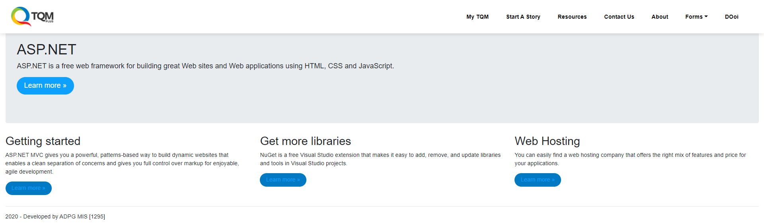
Home Page
Windows Authentication
“Start A Story” and “Forms” only applicable for PG User only and not including generic accounts.

Slide 3
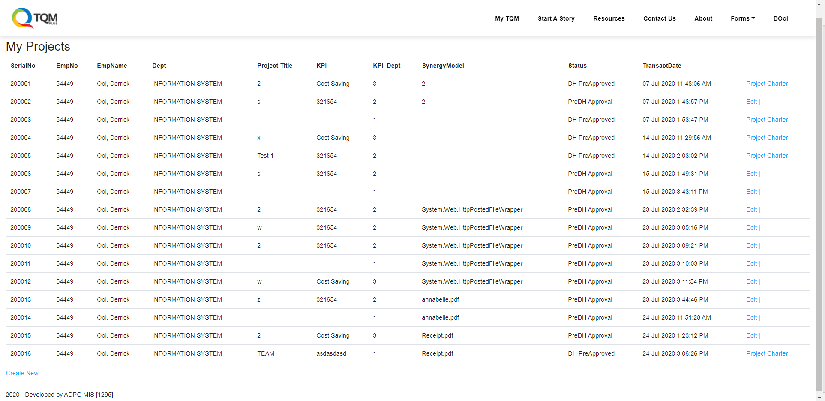
My Project Dashboard
Shows only your projects status
Action item are indicated clearly on the right
Able to Create New Projects

Slide 4
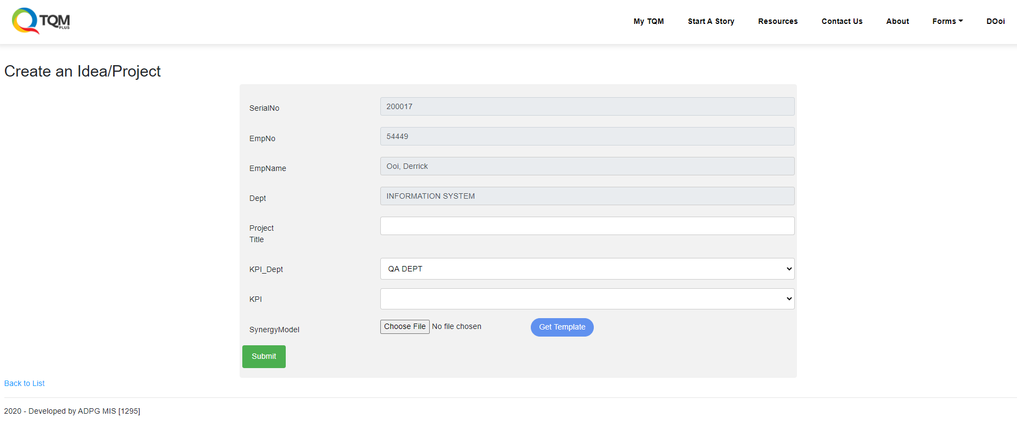
Start a story
Basic information is automatically captured.
Less effort required to start a story / project
- Project Title
- Select KPI Department
- Select KPI
- Upload Synergy Model

Slide 5
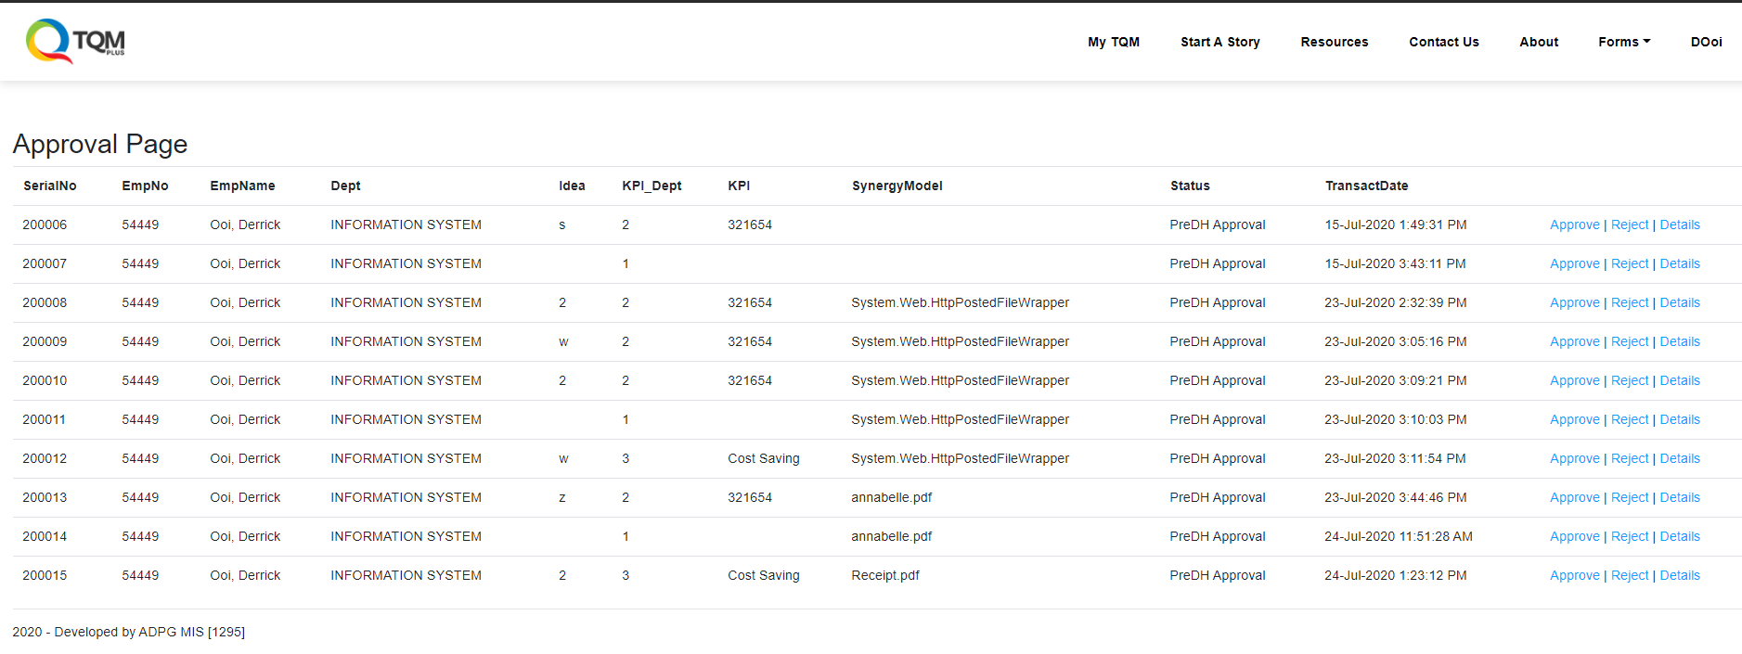
Approval Page
Only Authenticated User will gain access to Approval Page
Approve / Reject / Details Action Item is placed on the right side row of the project.

Slide 6
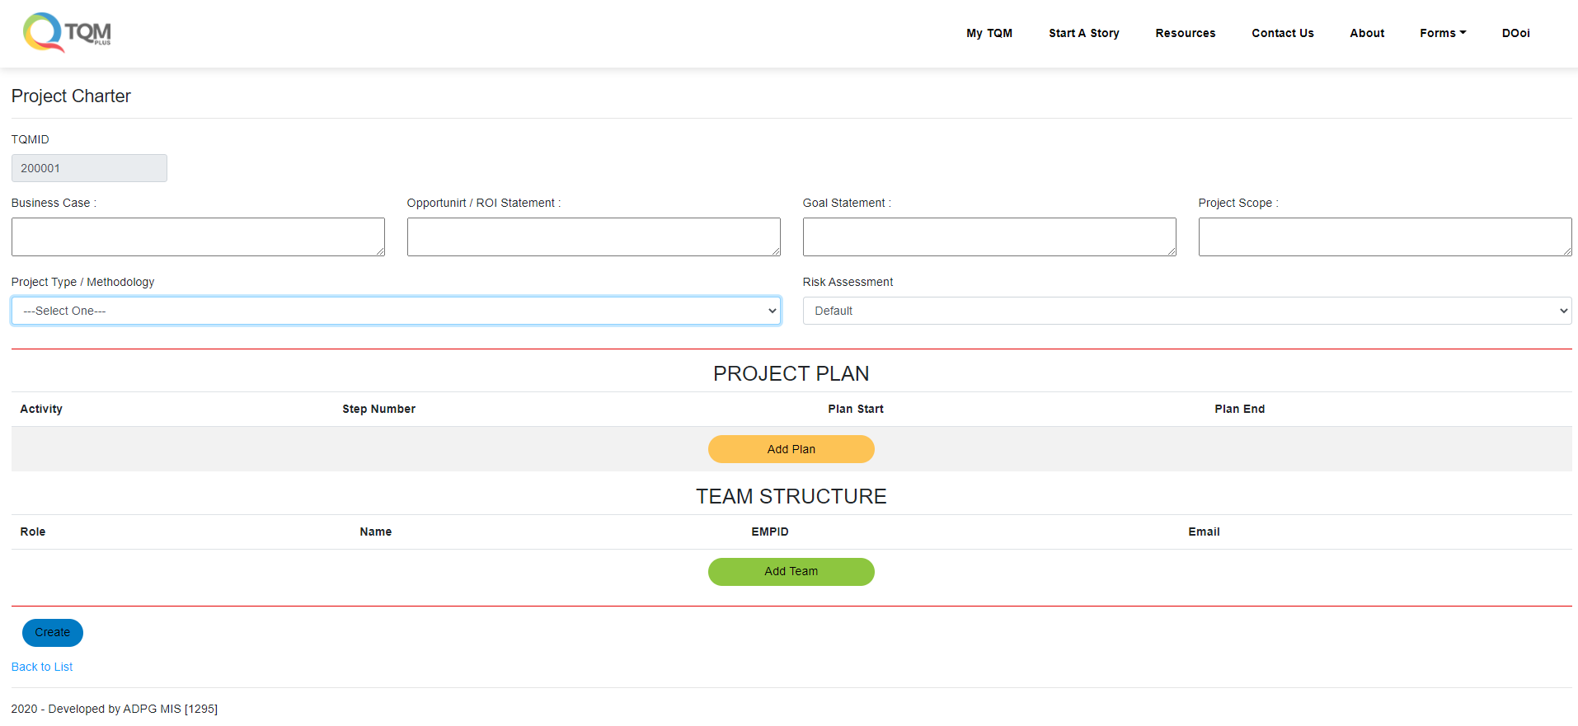
Project Charter
In-Progress
Project Plan and Team Structure are still in development progress as rules and user interface design are to be implemented.

Slide 7
Pending Action Item Required
Phase 1
Project Charter Data Entry
Facilitator Assignment / Approvals
Finance Justification
Diagnostician Assignment / Approvals
Final Project Charter Submission
Facilitator / Diagnostician / Finance Project Charter Buy-Off
Steering Committee Approvals
Phase 2
Step 1 to Step End Forms – Depends on methodology selected
Monthly Triggering – Email
Final Submit Completed Project - Story Presentation
End

Slide 8
Hardware Management System

Slide 9
Pending Action Item Required
Barcode Printing / Labelling
Email Triggering Point
Final Testing
Deployment

Slide 10
End

